Slide 1
I Know I Will Be Wrong Creating the Best Projections You Can
Written by
John F. Levy
MBA and CPA

Slide 2
“All we really know is the past but all that really matters is the future.”

Slide 3
Session Objectives
To understand:
How (or if) to consider the past in company budgeting.
The critical roles of strategic planning and risk management in developing best projections.
Current budgeting and projections best practices.

Slide 4
Session Objectives
To understand:
How benchmarking and metrics have changed the budget process.
How the many uses of budgets and projections can cause distortions.
That however you choose to create your budgets and projections, one thing is certain, you will be wrong.

Slide 5
Why Budget?
Allocate scarce resources
Determine business needs:
  Financing
  Personnel
  Equipment
Plan operations
Evaluate performance

Slide 6
The Virtuous Circle
Goals
Plans
Actions
Measurement
Adjustment
Goals
Plans
Action
Measurement
Adjustment

Slide 7
Goals
Shareholders
Board of Directors
Executive Management
General
Broad
Specific
People with goals succeed, because they know where they're going.
-Earl Nightingate

Slide 8
Plans
“If you fail to plan, you plan to fail.”
- Anon.

Slide 9
Allocation of Resources
Minutes are worth more than money. Spend them wisely
-Thomas P. Murphy
Time
I've got all the money I'll ever need, if I die by four o'clock.
--Henny Youngman
Money

Slide 10
Actions
Strategic
  Strategy is what your company does to create a sustainable competitive advantage.
Tactical
  Specific actions taken to implement the strategy.

Slide 11

The Hedgehog Concept
Opportunity to be
Best in World
Opportunity to be best
Business
that invokes management’s Passion
What
Drives Economic Engine

Slide 12
How to Budget
Top Down
Bottom Up

Slide 13
Types of Budgets
Aspirational
Realistic
Slam Dunk

Slide 14
How Budgets Affect Actions
Control
Communication
Measurement
Planning
Compensation
Responsibility
Authority
Internalize Goals

Slide 15
Budgets Gone Bad
Unrealistic expectations
Improper communication
Financial budgeting
Improper metrics
Sandbagging
Fiefdoms
Expenditure approval

Slide 16
Budget Fixes
Participatory budgeting
Aligning budgets with strategy
Develop a communication plan
Budget for managing
Don’t allocate
Develop responsibility centers
Don’t substitute the budget for purchase or commitment authorization

Slide 17
Revenue Forecasting
What Drives Revenue?
More customers
More revenue from existing customer
New products
New markets
External changes

Slide 18
Cost Projections
What Drives Costs?
Know your cost structure
How critical is payroll?
What can you control?
Can you outsource?
Where are the risks?

Slide 19

Cash Forecasts
Cash is King
Develop balance sheet assumptions
Project cash at least
monthly
What can you control?
Will your line be available?
Where are the risks?

Slide 20
CSFs and KPIs
An organization’s critical success factors (CSFs) depict its business cause/effect chain
Metrics that measure CSFs are key performance indicators (KPIs)
All 11 Good to Great companies measured profit/something.

Slide 21
Benchmarking
Changes budget focus from what did we do in the past to what should we do next?
Reduces politics
Focus on metrics, rather than $
Volume changes required no plan revision

Slide 22
Key Factors to Benchmark
Financial
  Pricing
  Cost of key activities
  Margins and profitability
Customer
  Satisfaction
  Critical product features desired and the value they place on these features
Notes:
We can best interpret other company’s information when we convert it to a revenue, cost or margin per unit.

Slide 23
Key Factors (cont’d)
Operational
  Productivity
  Quality
Learning
  Investments in training
  Investments in research & development

Slide 24
Balanced Scorecard
Developed by Robert Kaplan and David Norton.
Felt organizations focused too heavily on “financial measures”.
Historical reporting techniques no longer appropriate in the “information age”.

Slide 25
Balanced Scorecard
Historical results are lagging indicators lacking predictive power
Benefits:
  Translate strategy
  Quickly anticipate financial results
  Align employee action
  Create value with intellectual assets

Slide 26
Balanced Scorecard
The root cause of dissatisfaction is over reliance on financial measures
Intangible assets are the key to producing value in today’s economy
    Employee knowledge
    Customer and supplier relationships
    Innovative business processes

Slide 27
Key Benefit
Balances financial measures with the drivers of economic success to enhance strategy execution.

Slide 28
The Balanced Scorecard
Financial
Learning
& Growth
Strategy & Vision
Customer
Operations

Slide 29
Strategy Translated into KPIs within 4 Balanced Perspectives
Learning & Growth
  “To achieve our vision, how will we sustain our ability to change & improve?”
Internal Processes
  “To satisfy shareholders & customers, what business processes must we excel at?”

Slide 30
Strategy Translated into KPIs within 4 Balanced Perspectives
Customer
  “To achieve our vision, how should we appear to our customers?”
Financial
  “To succeed financially, how should we appear to our shareholders?”

Slide 31
Benefits of BSC
Two fundamental business issues are greatly enhanced:
    The problem of effective performance measurement, and
    The critical issue of successful strategy implementation.

Slide 32
Still Not Convinced?
Criticisms of historical financial measures:
Inconsistent with today’s realities
Driving forward using the rearview mirror
Reinforces functional silos
Sacrifices long-term thinking
Not relevant to many levels of organization

Slide 33

Measurement
Everything should be made as simple as possible, but not simpler
-Albert Einstein
Notes:
He looks like Carl Weathers when he played “Apollo Creed” in Rocky!

Slide 34
Financial Report Design Considerations
Purpose
Content
Format
Frequency
Timing
Accuracy
Method

Slide 35
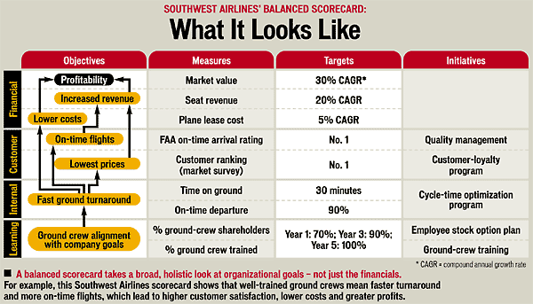
Southwest Airlines

Slide 36
Is This Good Performance?
 | Ground Crew Cost Report
 | Month Ending 3/31
 | Actual | Budget | Difference | % Diff.
Wages | $2,107,302 | $2,204,634 | $(97,332) | (4.4)%
Benefits | 749,585 | 775,927 | (26,342) | (3.4)%
Other Expenses | $ 279,880 | $ 306,475 | $26,595 | (8.7)%
Total Expenses | $3,136,767 | $3,287,036 | $(150,269) | (4.6)%
Notes:
At first blush, our reaction may be that this is good performance since the manager spent 4.6% less than budget. However, being under budget by only 4.6% would not be good news if the airline abandoned 15% of its routes at that airport since accounting developed the budget. Did the airport loose three days worth of operations because of a once-in-a-decade blizzard? Would the company’s ground crew at this airport be cost effective compared to other airlines or compared with the company’s ground crews at other airports? Where is the link to the company’s strategy or to overall company performance?

Slide 37
Is This Good Performance?
 | Budget to Actual with Metrics
 | Month Ending 8/31
 | Actual | Budget | Difference | % Diff.
Wages | $117,302 | $104,634 | $12,668 | 12.1%
Benefits | 40,927 | 39,585 | 1,342 | 3.4%
Other Expenses | 39,880 | 36,475 | 3,405 | 9.3%
Total Expenses | $198,109 | $180,694 | $17,415 | 9.6%
Output Units | 16,980 | 15,267 | 1,713 | 11.2%
 | $11.67/unit | $11.84/unit | $(0.17)/unit | (0.1)%
Notes:
Benchmarking has effectively turned the financial planning process upside down. Instead of estimating the future costs of a list of financial statement line items, the establishment of the target metric, derived from the benchmarking data, allows the company to develop a spending plan by beginning with the end goal.
Does the company need to develop targets for specific line items? For example, would we have to know how much a department plans to spend for wages, benefits and supplies? In theory, a company would be able to skip the traditional budgeting process by coming up with metrics for each department, such as a $7.50 per invoice plan for the accounts receivable function. While executive management may care significantly less about detailed costs within individual departments once the company introduces metrics, the managers of the responsibility centers are likely to continue to be concerned about the details of how they are going to meet their goals.

Slide 38

Risks

Slide 39

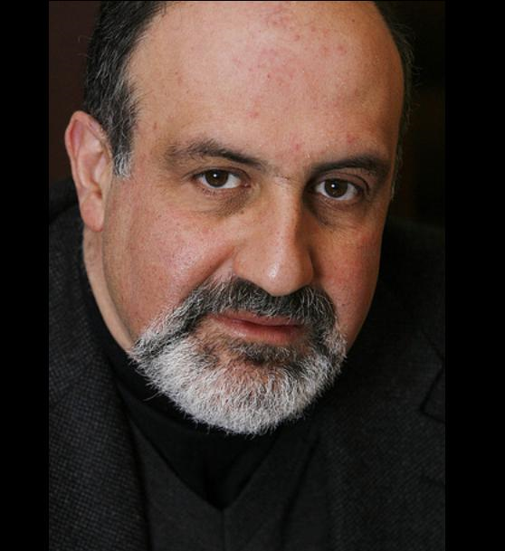
The Black Swan
Nassim Nicholas Taleb

Slide 40
What Is A Black Swan?
A black swan is:
  An event unlike any before
  With extraordinarily high-impact
  After the fact explanation

Slide 41
Examples of Black Swans
Examples include:
  Penicillin
  The Railroad
  Christianity
  World War I
  9/11
  The Plague

Slide 42


Mediocristan
Extremistan
The total can be impacted
by a single instance
No single observation can impact the total

Slide 43
Mediocristan
Extremistan
Contingency
Hourly Billing

Slide 44
Confirmation Error
We look to confirm our beliefs, models or constructs:
  No evidence of ______ ≠
  evidence of no ______
  Evidence of ____ is not confirmatory
  Time horizons need to be longer

Slide 45
Narrative Fallacy
We are biologically predisposed to make stories from facts:
  Man and wife die. (Wife dies of broken heart immediately after husband.)
  Rationalize away black swans
  Dangerous when limiting future actions

Slide 46
The Turkey

Slide 47
The Turkey

Slide 48
Moral
The past is an imperfect projector of the future.

Slide 49
The Fallacy of the Bell Curve

Slide 50
Focus on What Matters

Slide 51
Or You Could Miss the Mark

Slide 52
What Do You DO
In light of predictive problems:
  Scenario planning
  Disaster planning
  Notice fixed costs
  Look for outliers
  Look outside your comfort zone
  Focus on leverage
  Get cushions
  Look for inflexibility
  Don’t sweat the small stuff

Slide 53
Questions?

Slide 54
John F. Levy
Board Advisory
John@BoardAdvisory.net
www.BoardAdvisory.net

